Slide 1
Arrowhead Framework development coordination:
21-05-11 at 15.30
Meeting link:
https://ltu.webex.com/ltu/j.php?MTID=m53372c08f6c7a095410d9b4fa3ee220f

Slide 2
Agenda
New systems, interoperability and tools
How do we move from a coding project to a solution ecosystem?
Eclipse Arrowhead v5.0 roadmap, Jerker
Updates on release candidates SysML 1.6 profile & core system models - Jerker WorkflowManager/WorkflowExecutor, Jaime, TestTool, Hans Sandboxing tool, Hans C++ of v4.2
Updates to prototypes Code generation from SysML, Saadia Consumer code generation, Cristina PlantDescription, Olov/Johan ExchangeNetwork, Ulf/Emanuel Autonomic orchestration/configuration, An Security mitigation tool, Silia Security compliance test, Ani Vorto, Hono and Hawkbit, Johannes ESB, CPN, NodeRed, Felix Translation - Semantics, Jacob SysML2 - profile, Oystein/Geza/Jerker C# and .net library Safety Manager, Mirren/Daniela (on-hold) Kura and Kapua, Paolo
Updates on engineering Engineering process, Jan/Gianvito Engineering tool chain, Marek/Federico Engineering tools, Hans/Pal
Updates on training Training, HW, SW, literature, Mattheui/Emmanuel/Mats Training tool, Sebastian/Marcello/Saadia
Next telco May 25 Feature contributions: OPC-UA, Aparajita User authentication, Feidor

Slide 3
MoM
Sign up for the Eclipse Arrowhead mailing list arrowhead-dev@eclipse.org at https://accounts.eclipse.org/mailing-list/arrowhead-dev
MoM at www.github.com/exclipse-arrowhead/roadmap

Slide 4
1) New interoperability and tools
Arrowhead Framework connector for PREM compiler - CAMEA (extension of clang/LLVM) and scheduler is now available (https://github.com/CTU-IIG/ah-prem-sche
Shell to AH Framework - IKERLAN
EDGE MONITORING TOOL - REPLY Edgex microservices are installed on the gateway with K3S and so there’s the need to verify easily in every moment if all the microservices are working perfectly. For this purpose, the Edge Monitoring Tool is implemented. In order to get the health status of the microservices, Vital-IoT makes a request to the gateway with a predefined frequency of time. So a JSON message arrives on the MQTT broker on the topic “topic/service-status-req” that requires the status of the microservices. The Tool is subscribed to that topic and when the request arrives, it searches for the list of microservices available at that moment. When the Tool knows the name of the microservices, it recalls an Edgex API for every single microservices that returns the health status. Below, the health status is represented in the dashboard by a colorful circle. It’s green when microservice is up, red when is down; notice that some microservices don’t have a health API, so they are marked with a grey circle.
RoboFuse adaptors to be able to integrate it with AHT, - ROPARDO
RoboFuse Control Panel
Custom Integration
Stream Process When all these areas are completely functional from RoboFuse will be possible to, register RoboFuse as data provider for any AHT Instance, register end point where Robofuse can ingest data from AHT Instance.
Register an RoboFuse application and associated devices with AHT Authorization.
Publish device data from RoboFuse to the AHT Service Registry / Orchestrator
Publish RoboFuse ingest end points to the AHT Service Registry / Orchestrator
BEIA IoT tool - BEIA
NodRed based tool

Slide 5
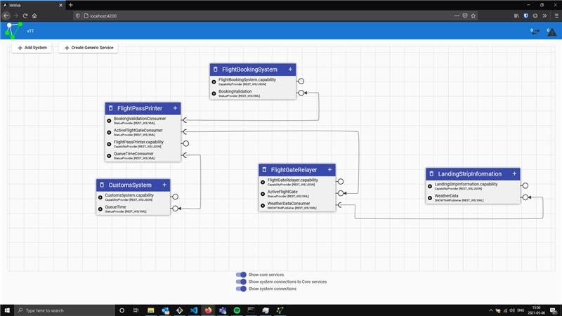
Test Tool
1 Implementing 2 new communication profiles
UPC-UA
MQTT
2 Meeting with Emanuel discussing technology for graphical presentation of System of Systems

